Slide 1
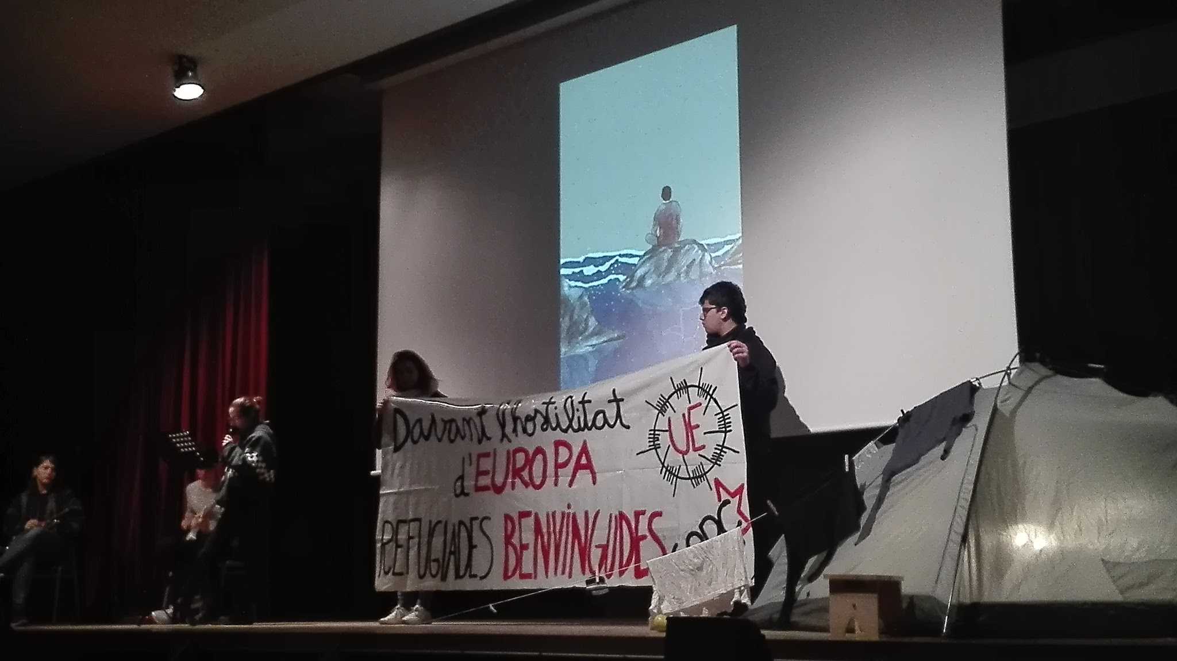
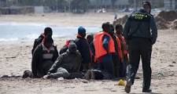



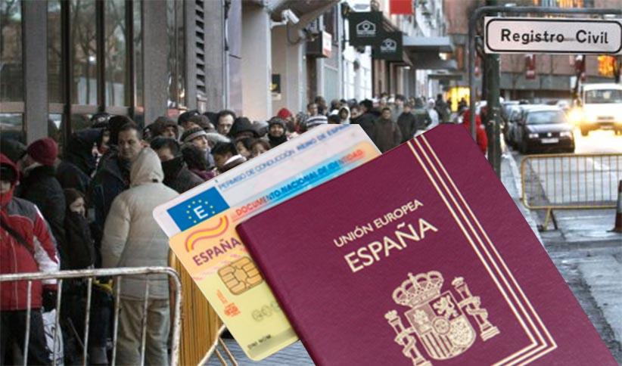
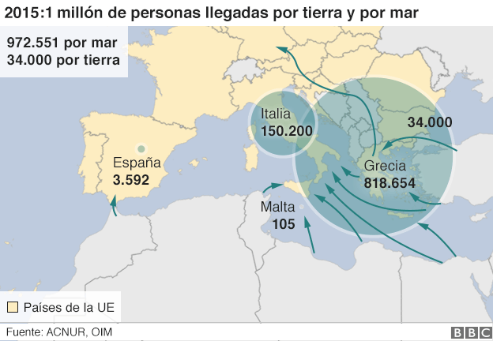
Arrives before the 2000
Izan Gomez-Diego Lledós-Paula Salgado-Othmane el Jhouari-Oriol Bravo
When?
In 2000 the immigrants of South America, Morocco and people of east Europa (Bulgaria, Romania and Polish), start to arriving a lots of they.
Why? (causes)
Consequences.
For the country causes aging and depopulation. For the host country, decreased wages, degradation of housing, cultural diversity and economic development.
To emigrate, first and adaptation problems of identity and, ultimately, improved quality of life.
The causes of migration are diverse, but include the demographic and economic those related to natural disasters, the political, cultural, etc. What they want for themselves and their families is to find a place to live and work without problems or wars
From where they come?
Immigrants arriving from Africa and Asia
Thousands and thousands of people, usually loaded on boats and old, crossing the sea to reach Europe.
According to sources in the EU country where it came from immigration over 2014 was 123,000 immigrants Syria
The next country was Afghanistan with 41,000 people, followed by Eritrea with 37,000 people, 22,000 immigrants Pakistan, Iran and Nigeria 21,000 20,000.
Notes:
Copyright Colin Purrington (http://colinpurrington.com/tips/academic/posterdesign).
‹#›

